Slide 1
Mt1: The development of modern political thought
LT#2: I will know the important people of the enlightenment and their key beliefs

Slide 2
Back in the old day thinking
Believe everything the church says!
Everyone is very suspicious
Anyone who goes against the church is evil!
Believe everything the King says!
Example: The king gives you your rights. The king and the government can do whatever they want because they have ALL the power. You must follow the government. Everything belongs to the king!!!
Only 15% of the population could read (15/100)
Only 10% of the population went to school (10/100)

Slide 3
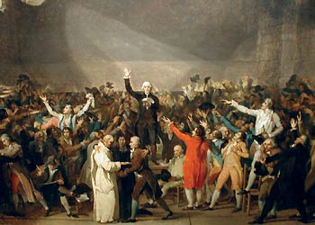
Enlightenment
A movement that started in the 1700’s in Europe to challenge traditional beliefs ( the old ways of thinking)
Changed with reason, intelligence and thought
Enlightenment impacted/Changed
Government, nations and politics
Religion
Science

Slide 4
Important people and Ideas
John Locke – natural rights
Baron de Montesquieu – Separation of power
Jean-Jacques Rousseau – Social contract

Slide 5
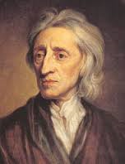
John Locke: Natural Rights (1690)
Ideas
People are born with natural rights
Right to have life, the right to have freedom (liberty) and the right to own possessions (property)
Peoples rights come from God (rights are “endowed” by God)
No one can take rights away
People give the government it’s power
The people control the government
If a government violates the rights of the people the people have the right to overthrow (fire) the government.
Watch this video
https://youtu.be/pZBs78WQuUc

Slide 6
Create a bubble map
John Locke
Add information about John Locke and his ideas
After completing bubble map write a short summary about John Locke’s ideas.

Slide 7
Baron de Montesquieu (Charles-Luis)
IDEA: Separation of Power
A governments power should be divided up/ separated
No one person should have all the power in/for a government
Why separation of power is good?
Keeps government from gaining too much power
Controls corruption
Keeps the government from violating the rights of the people/citizens
Watch video
https://youtu.be/e1cN5KuB5s0

Slide 8
Create a bubble map
Montesquieu
Add information about Montesquieu and his ideas
After completing bubble map write a short summary about Montesquieu's ideas.

Slide 9
Jean-Jacques Rousseau: Social Contract
He said that people enter/join into an agreement with their government
The government rules based on the will of the people(what the people want)
He believed that people are basically good
Because people are good they will follow laws for their own good
This then gives people the right to create their own laws

Slide 10
Tree Map
Enlightenment Thinkers
 | John Locke | Montesquieu | Rousseau
Main Ideas
Impact/importance of idea

Slide 11
Thomas Jefferson: The Declaration of Independence
He was influenced by the beliefs of natural rights, and social contract
He added A LOT of stuff about natural rights and social contract into the Declaration of independence
“Laws of Nature and Natures God” = Natural Rights
“endowed by their Creator with certain unalienable rights…life, liberty and the pursuit of happiness” = Natural Rights
“to secure these rights, governments are instituted among men” – social contract
“deriving their just powers from the consent of the governed” – Social contract and natural rights
“when ever any form of government becomes destructive it is the right of the people to alter or abolish it – natural rights

Slide 12
James Madison: USA Constitution
The Constitution has enlightenment ideas
Bill of rights – a list of the first ten rights the government promises to protect = natural rights
Three branches of government – Executive, legislative and judicial branches = Separation of power
President, senators, representatives – Social contract and Locke's ideas about representative government

