Slide 1
US History MT3: The United States as a World Power
Learning Target #1:
What was the open door policy?
What were the effects of the open door policy?

Slide 2
Assignment
Look at the power point
You do not need to take power point notes
Answer all the questions and turn this in with handout #1

Slide 3
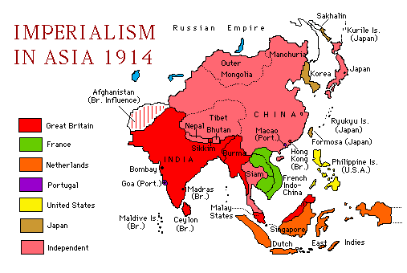
Imperialism
What is imperialism:
When powerful countries gain control of other countries either peacefully or by force
Powerful countries develop/create colonies in different parts of the world

Slide 4
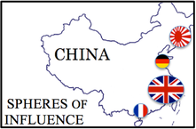
Spheres of Influence
What is a sphere of influence?
When a powerful nation controls land in another nation
Example: When the England controlled a part of China’s land to trade and take natural resources

Slide 5
Questions
What is imperialism?
What is a sphere of influence?
What nation (from the map on slide 2) did not have a “sphere of influence” in China?

Slide 6
Imperialism
Why?
Who imperialized?
Which nations were imperialized?
To create trade with other countries
Sell products
Buy natural resources
To protect ports (access to the ocean and land in a country)
Not wanting to pay high tariffs (taxes)
Japan
Russia
Britain
France
Netherlands
Portugal
Later: USA
China (and other areas of Asia)
Africa
Latin America

Slide 7
Questions
4. Why did nations practice imperialism?
5. Identify two nations that practiced imperialism?
6. What parts of the world were imperialized?

Slide 8
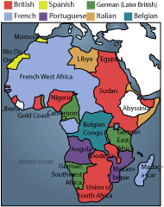
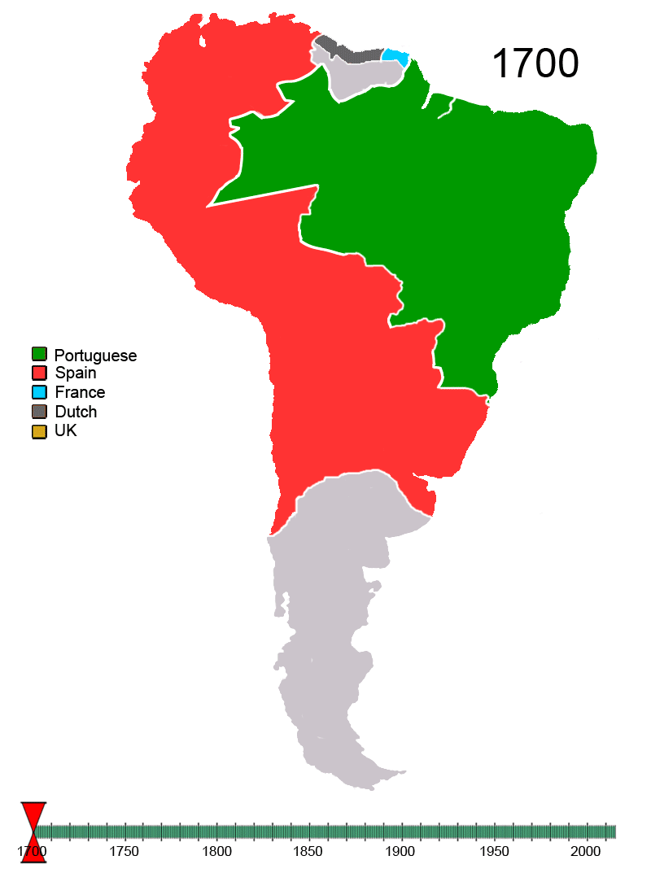

Slide 9
USA gets involved in Imperialism
US believed they needed to be involved in imperialism in order to be competitive with other powerful nations
US wanted to trade with Japan and China = place to sell products (USA had plenty due to the industrial revolution)
USA needed area to rest ships traveling to China and Japan soo they took over Hawaii

Slide 10
Questions
7. Why did the USA start practicing imperialism?
8. Why did the USA take over Hawaii?

Slide 11
Development of the Open Door Policy
USA wanted to trade with China (China had silk, and spices) but Russia, Great Britain and Japan had Spheres of influence in China
Why a problem:
Those countries charged high taxes on trade and limited trade with China
USA did not want European countries to monopolize (have total control) of China’s trade
USA creates a plan to keep European countries from controlling all of Asia (monopolizing China)
PLAN: Open Door Policy
Plan of action (idea)
All countries could trade with China
No one country could have total control of China

Slide 12
Questions
9. What is the open door policy?
10. Why was the open door policy created?

Slide 13
Effects of the Open Door Policy
All countries could trade with China
China had little or no say in who it could trade with
Chinese resented western influence (European and USA influence) on its culture
Chinese rebels called Boxers created a revolt
Boxer Rebellion
Killed 200 non Chinese people
USA and other countries stopped rebellion
The USA also wanted to share democratic ideas with China
All nations in the west exploited China (took their natural resources, abused the people, disrespected their traditions and wishes)

Slide 14
Questions
11. What were 3 effects of the Open door policy?

