Slide 1
Lt#3: Explain Theodore Roosevelt’s Big Stick Diplomacy, William Taft’s Dollar Diplomacy And Woodrow Wilson’s Moral Diplomacy
MT3: The USA as a World Power

Slide 2
Review
MT3 is about the USA becoming a world power
They started by creating the open door policy with China
The USA made the rest of the world listen and respect them when they stated that ALL nations could trade with China and that not one nation could control it.
The next thing the USA did was build the canal in Panama
This meant that if other nations wanted to us the canal they had to be on good terms with the USA. So if the USA did not want to let their ships through the canal the USA had the power to say no way!
Nations had to respect the power of the USA
In the following slides you will learn how the Presidents of the USA further got involved in world issues to make the USA a world power

Slide 3
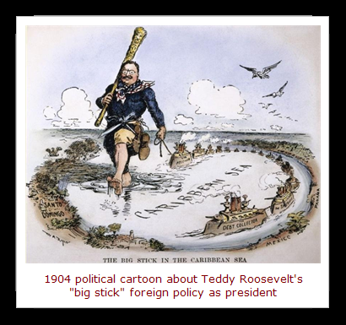
Theodore Roosevelt: Big Stick Diplomacy
Theodore Roosevelt was president from 1901 to 1908
He believed that the threat of violence was more effective than actual violence
He used an old African saying, “Speak softly but carry a big stick”
He used this saying to steer the USA into becoming a world power
He built up the USA navy and army to provide a threat

Slide 4
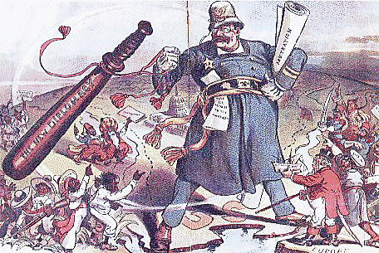
Theodore Roosevelt: Big Stick Diplomacy
Roosevelt main goal with his “Big Stick Diplomacy” was to keep European countries from interfering with Latin American
Roosevelt wrote a speech called the “Roosevelt Corollary”
He said that he would use force to keep Europe out of the “Americas”

Slide 5
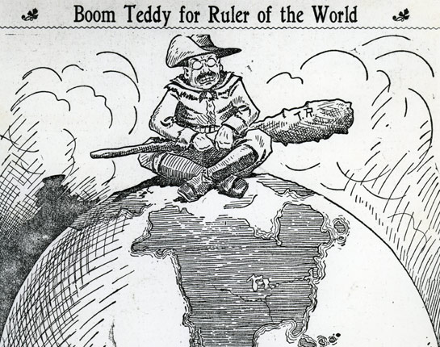
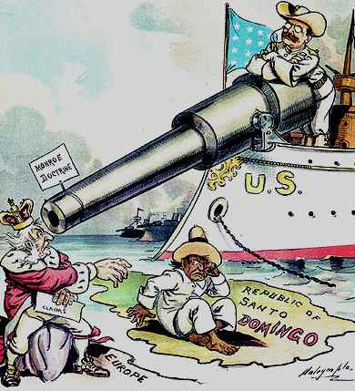
Questions
What is the idea o f “carry a big stick”?
What was the Roosevelt corollary?
What do the images to the right represent?

Slide 6
William Howard Taft: $Dollar Diplomacy$
President from 1909 to 1912
He believed in “substituting bullets for dollars”
He wanted to protect US investments in Latin America
Bananas, sugar, coffee
He believed if he invested money in Latin American countries he could
help them financially
keep Europe out of the area
protect Americans' investments.

Slide 7
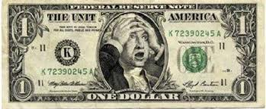
William Howard Taft: $Dollar Diplomacy$
Taft’s idea was to loan money to Latin American nations
He thought this would help the Latin American countries improve
What really happened was the Latin American countries never really improved

Slide 8
Questions
What was William Taft's belief?
What happened after the USA gave money to the Latin American nations?

Slide 9
Woodrow Wilson: Moral Diplomacy
President from 1913 to 1921
He did not agree with Taft’s dollar diplomacy
He only wanted to support countries that had democratic governments

Slide 10
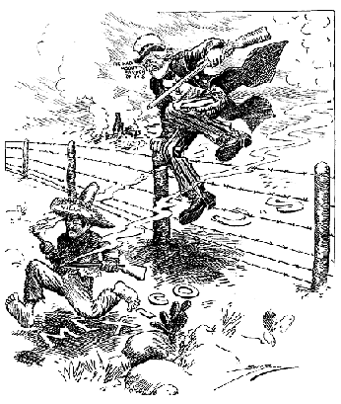
Moral Diplomacy
Moral Diplomacy- was Wilson’s idea that the USA should only support countries with a democratic governments
Mexico’s revolution in 1911 put a dictator named Huerta into power = non democratic Gov.
Wilson said the USA had a moral obligation to put a good Gov. into place
The USA sends troops into Mexico, Pancho Villa attacks US cities and in the end nothing changes in Mexico.

Slide 11
Questions
What was moral diplomacy?
Why did the USA get involved in Mexico issues?
What happened when the USA tried to help Mexico put in a democratic government?
Create a tree map of the three presidents and their ideas/beliefs
Three presidents
President name
Idea/belief
Effect/action

