Slide 1
MT: 4 The causes and the effects of WW2
LT 1 Driving Question: How were Totalitarian leaders from around the world able to take over nations, build empires and murder millions?

Slide 2
Vocab/Terms
Totalitarian - To have total control ( To have all control over a government, the people and all parts of a nation)
Propaganda – information put out to encourage certain ideas or people, usually very deceptive or one-sided information
Vigilante – People who take the law into their own hands, don’t seek out police, mob violence

Slide 3
Problems in Europe after WW1
All nations bankrupt (broke)-little money
All empires dissolved-
New governments created were too weak – chaos, little government authority
People were suffering –poor, homeless, starving
People started strikes, riots, protests
People were looking for relief from:
Unemployment
Suffering
Starvation
Weak governments

Slide 4
Totalitarian Leaders rise to power
People who were suffering wanted help
Totalitarian leaders promised an end to all suffering
As a result of all the issues, people turned to/ listen to the false promises made by the following men:
Totalitarian leaders
Nation: Russia (Soviet Union)
Leader: Joseph Stalin
Gov.: Communist
Nation: Italy
Leader: Benito Mussolini
Gov.: Fascist
Nation: Germany
Leader: Adolf Hitler
Gov.: Nazi (national Socialist)

Slide 5
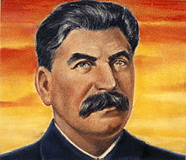
Russia (USSR-Soviet Union)
Big change happened in 1917 with the Bolshevik revolution when Lenin took over and made Russia communist.
Joseph Stalin took over when Lenin died four years later
Stalin made Russia a totalitarian Gov. by:
Brain washing
Controlled all newspapers, movies, radios, education, books, art
Destroyed churches and killed religious leaders
Economic $$$ control
Choose workers jobs and salaries
Choosing where workers lived
Created collective farms to produce food for Russia
Political control
Only communist
Total obedience
Secret police to enforce rules (police terror)
Tanks and weapons to stop protest
Tapping telephone lines
Jailed and executed

Slide 6
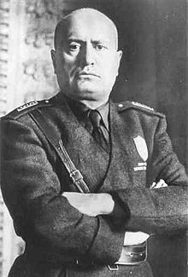
Italy = Fascist
After WW1 Italy had 5 different types of government
Benito Mussolini gains power and turned Italy into a fascist government
He promised to make Italy a great empire like the Romans
Fascist believe: the nation is more important than the individual –EXTREME NATIONALISM
No one was allowed to go against the government
How did Mussolini gain control:
Brainwashing:
He used propaganda: media, to promote people to support Fascist government
Government controlled newspapers, radios, books –The people only heard what Mussolini wanted them to hear
Parades to celebrate those who showed support of Fascist Italy
Political control:
Secret Police who had 100% power/control to arrest and jail anyone
Vigilantly, volunteer groups, were also used to terrorized the people
People were arrested, jailed, beat, tortured, killed, if they went against the government

Slide 7
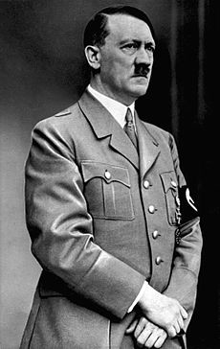
Germany- Nazi
Germany in the worst condition of all the nations
The new German government was weak
People upset, resented how they were treated after ww1, they wanted revenge
Unemployment, loss of pride (embarrassed), and loss of land
Adolf Hitler- Took over as the leader of Germany
He made promises, gave speeches, made the people feel that he could make Germany great again
Hitler believed that the Aryan race was superior and Jews, Slavic people, poles (Poland), and other groups were worthless
He convinced the Germany people that in order for Germany to be great again, only Germans could live
He created concentration camps to put Jews in
Created SS (secret police) to arrest and kill Jews
He gave the Germans hope for a better future

Slide 8
How are all 3 similar?
Used propaganda to support
Controlled media/press
Controlled people with terror
Denied/violated Individual rights
One dictator-people love
Secret police

