Slide 1
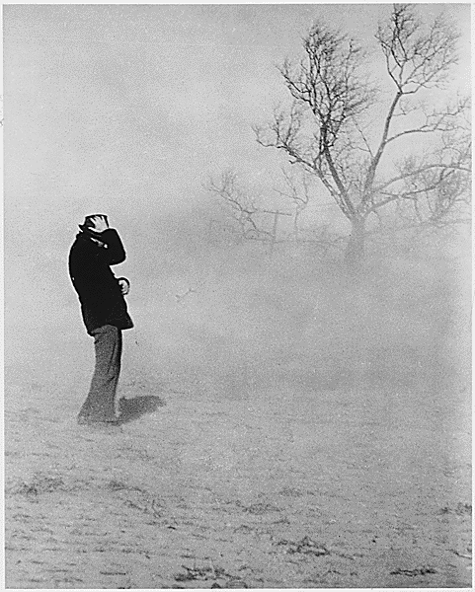
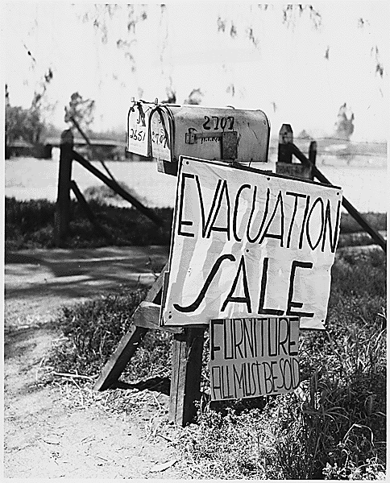
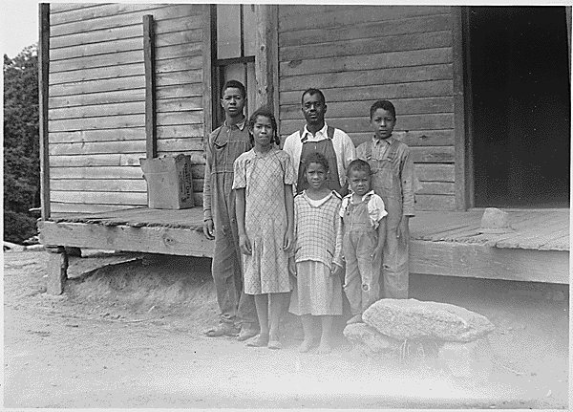
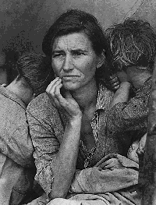
Effects of
the Great Depression
1929-1939

Slide 2
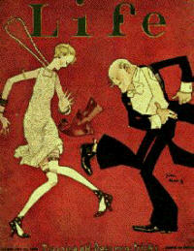
Before the depression life was GOOD
The new concept of “credit”
People were buying with credit:
Automobiles
Appliances
Clothes
Fun times
Dancing
Flappers
Drinking

Slide 3
Why was this bad?
Credit system
People didn’t really have the money they were spending
WWI
The U.S. was a major credit loaner to other nations in need
Many of these nations could not pay us back

Slide 4
The Stock Market
People bought stocks on margins
If a stock is $100 you can pay $10 now and the rest later when the stock rose
Stocks fall
Now the person has less than $100 and no money to pay back

Slide 5
And then….
With people panicking about their money investors tried to sell their stocks
Stocks were worthless (not worth any money)
People who bought on “margins” now could not pay for the stocks they had purchased
Investors were average people that were now broke

Slide 6
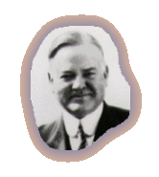
President Hoover
Herbert Hoover was president at the start
Philosophy: We’ll make it!
What He Did: NOTHING
He believed the people would figure out what they needed to do

Slide 7
Effects

Slide 8
Effects of the Great Depression Rural people (farmers)
Many lost their lands and homes because they could not pay off their loans
1929-1932 over 400,000 farms were lost to foreclosure.
Many people packed up and moved to California looking for agricultural work.

Slide 9
Effect on California
Thousands moved to California from areas effected by Dust bowl
California had a huge number of homeless
Californian’s were VERY, VERY HOSTILE towards the homeless people who moved to California
Not enough jobs for all the people
Those that found jobs were paid very, very little
They were forced to live in bad homes

Slide 10
A Farm Foreclosure

Slide 11
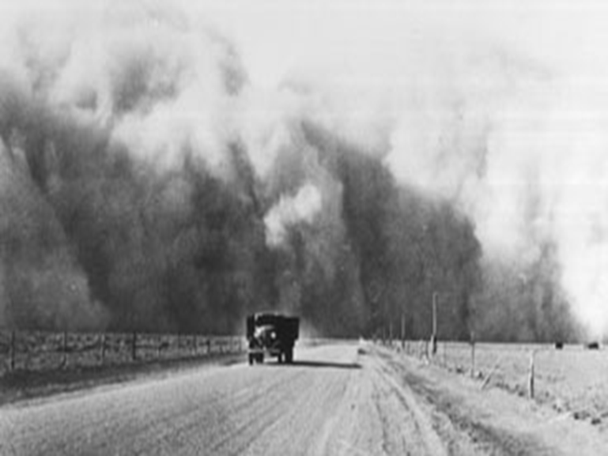
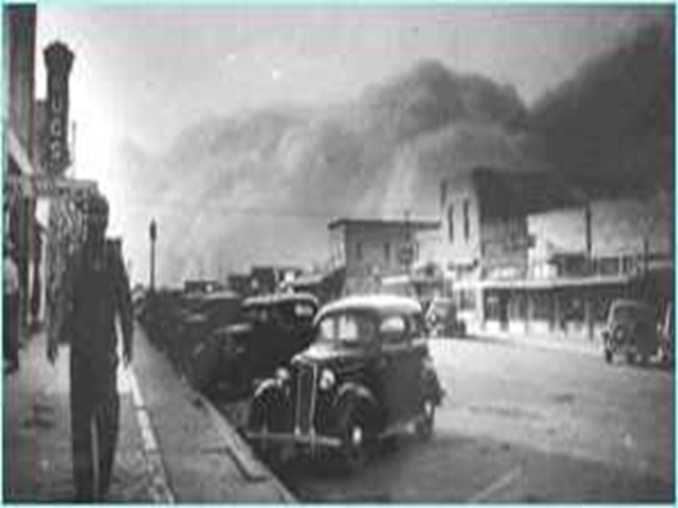
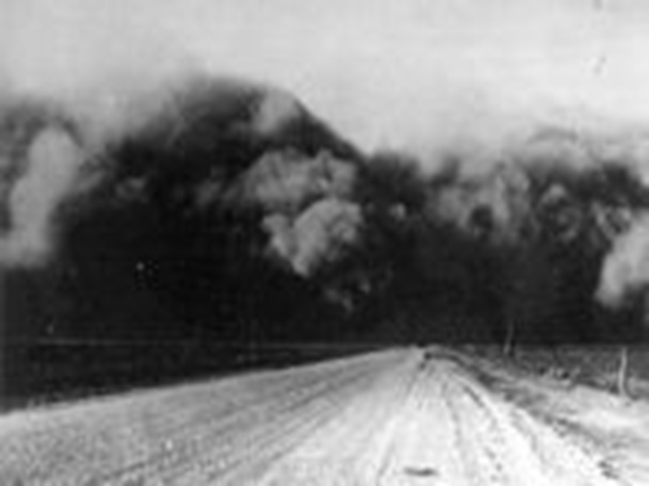
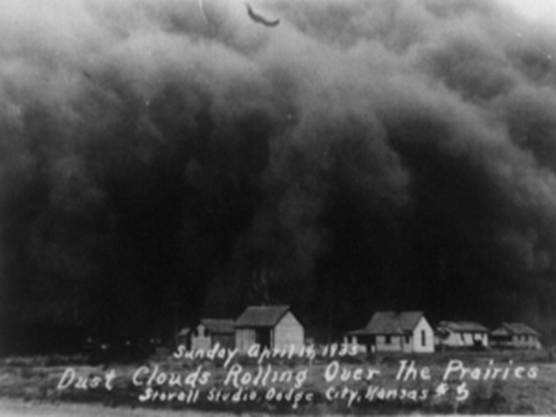
Dust Bowl

Slide 12
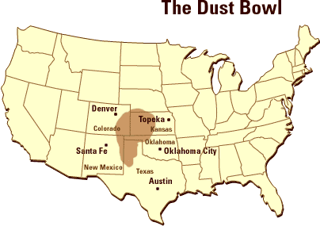
Dust bowl
Result : No crops = farmers have no money = farmers cant pay bills = lose farms = homeless, jobless, poor
Effected the middle states in the USA
Caused by:
Over working the ground = too much loose soil
Drought = no water or plants to keep soil down
High winds = blew dust/soil all over

Slide 13
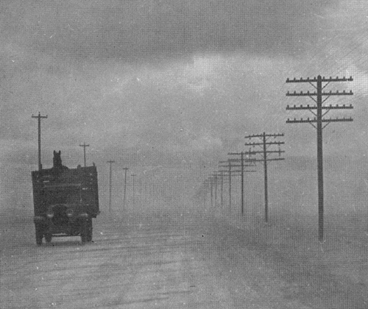
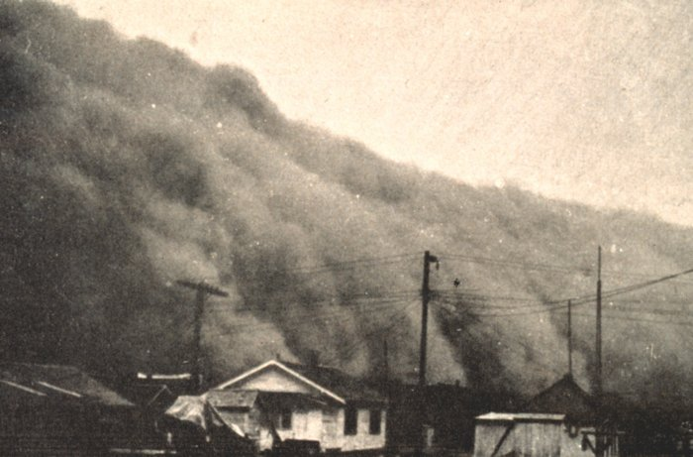
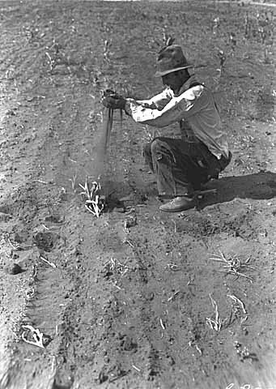
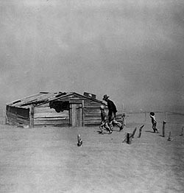
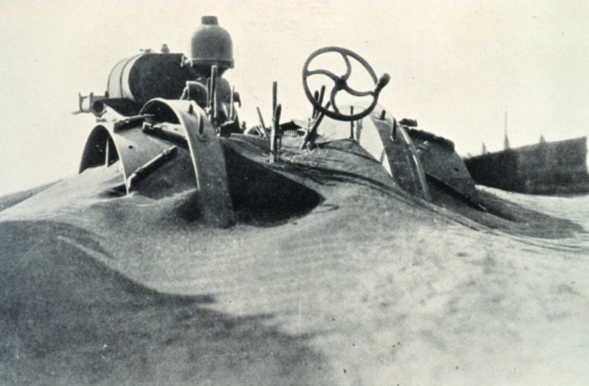

Slide 14
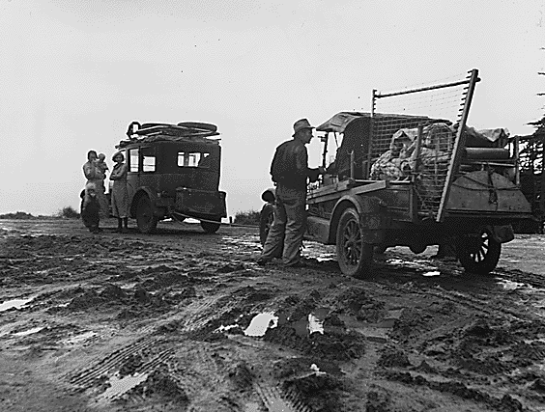
Some families were forced to relocate because they had no money.

Slide 15
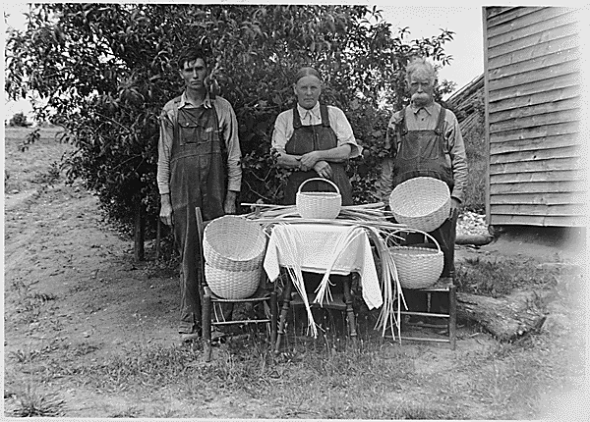
Some families tried to make money by selling useful crafts like baskets.

Slide 16
Great Depression in the Cities
Because large factories closed – small businesses and restaurants began to fail too.
No customers
No merchandise
Rich people laid off staff

Slide 17
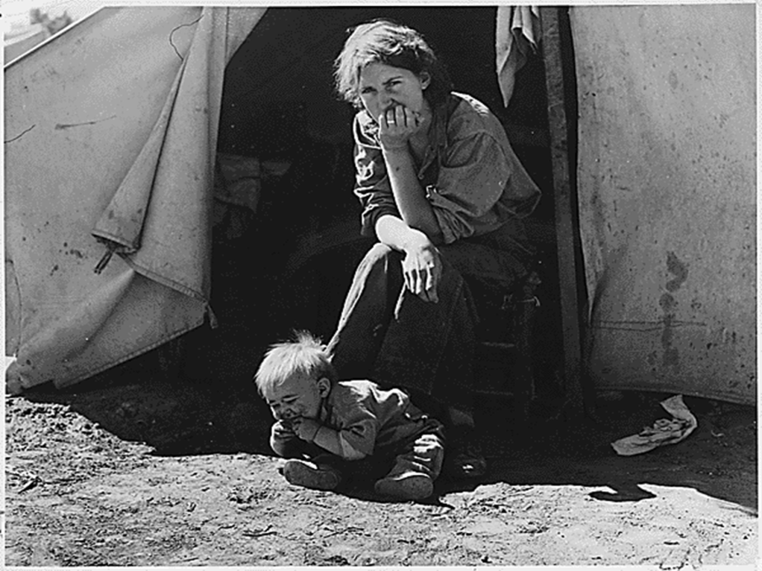
Homelessness
People in the cities not only lost their jobs, they lost their homes!
Many people could not make their mortgage or rent payments and ended up being homeless.

Slide 18
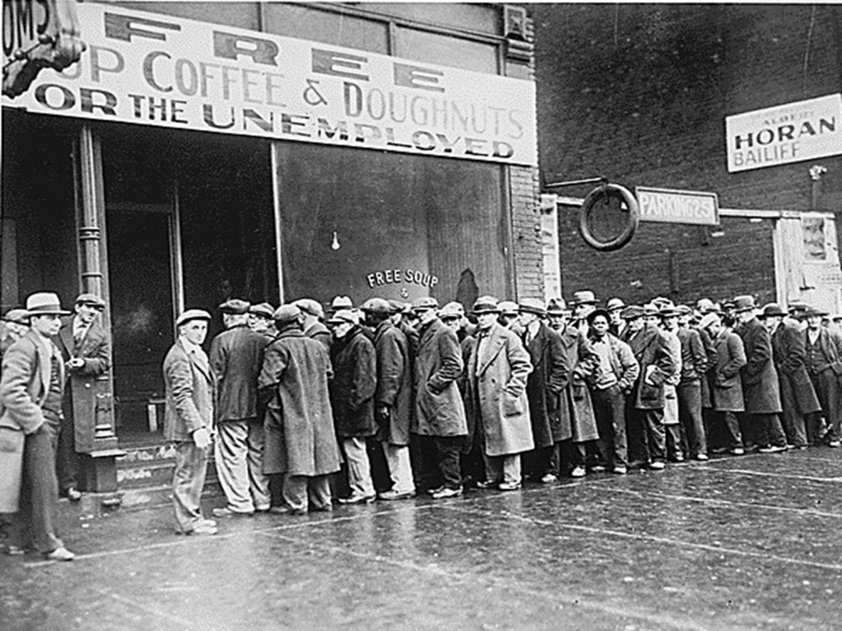
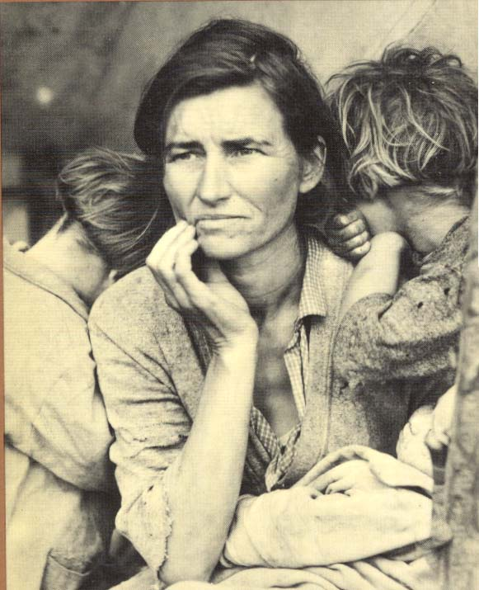

Slide 19
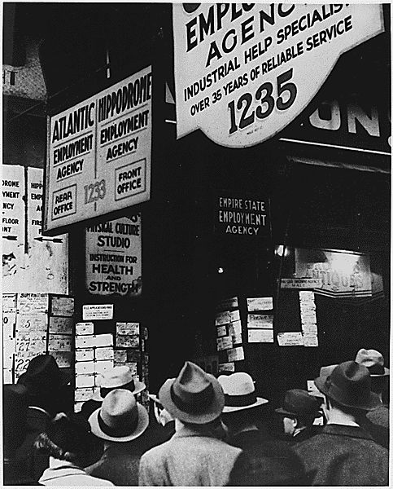
Many waited in unemployment lines hoping for a job.

Slide 20
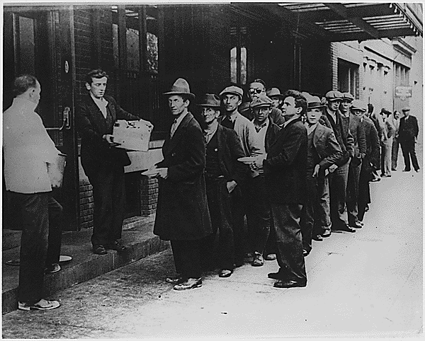
People in cities would wait in line for bread to bring to their family.

Slide 21
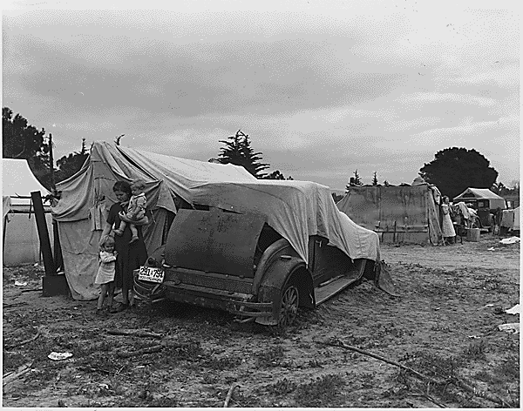
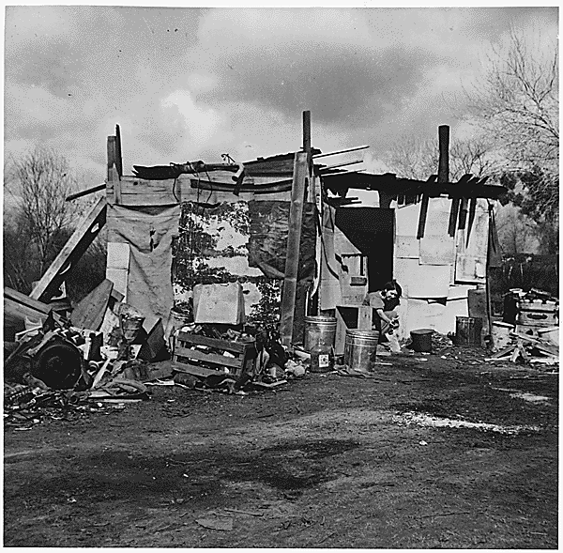
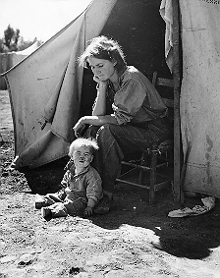
“Hooverville”
Some families were forced to live in shanty towns
A grouping of shacks and tents in vacant lots
They were referred to as “Hooverville” because of President Hoover’s lack of help during the depression.

Slide 22
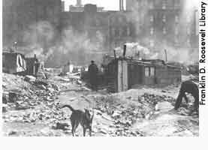
Hooverville

Slide 23
Effects of the Great depression
Men felt like failures because they could not provide for their families
This caused some men to leave their families
Domestic Violence - Beating of women/children
Police (who were mostly men) believed women lacked sympathy for their husbands so the husbands had a right to beat their families
When women left, they were advised to return home and make their men feel better.

Slide 24
Effects of the Great depression
Suicides increased 30%
Peoples health suffered because they could not afford to see the doctor/dentist
Thousands went hungry.
People begged for food.
People fought over the trash from restaurants
Schools shut down, kids went to work to help get money for their families

Slide 25
Questions
Why was life considered “good” before the Great Depression?
What three things to you think caused the great depression?
What did president Hoover do about the great depression?
How did the Great depression effect rural areas?
How did the great depression effect California?
What was the dust bowl?
How did the great depression effect people living in the cities?
What were hoovervilles?
What were 3 effects of the great depression?

