Slide 1
US History MT6: American Participation in WW2
LT:3- How did the war affect people living in America?

Slide 2
USA prepares for war
Prior to joining the WW2, American had already began building up its military power
50,000 planes a year
Congress passed the Draft: mandatory military service
USA government gets private business to produce military equipment
Cost-plus program
US Gov. paid for military supplies
The faster a company did its work the more money it would make resulting in war products made quickly
Examples: auto factories made tanks, jeeps, trucks, rifles, mines, helmets, bridges, pots, bullets, ect. (Ford build airplane bombers on his assembly line)

Slide 3
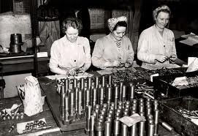
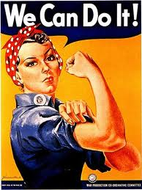
War at Home (Women and Minorities were needed)
Women
Prior to WW2 most women were expected to stay at home
After the war started, there was a shortage of workers in factories
Women were hired to build, ships, airplanes, rifles, bullets, etc.
Women also enlisted in the military as nurses, secretaries

Slide 4
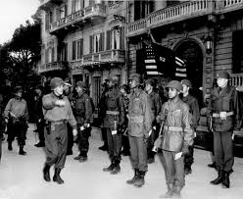
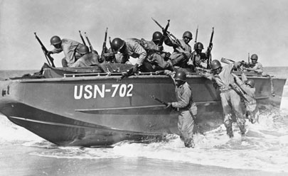
War at Home (Women and Minorities were needed)
African Americans
Could join military but only in segregated (separate) groups
At first many did not join because of racism
Idea of Double Victory – win racism in USA by joining and against Hitler
Many joined
White women hired in factories before a black man
Roosevelt signed Executive order 8802 on 6/25/1941 that everyone had equal access to work
http://www.youtube.com/watch?feature=player_detailpage&v=vGpP3mj6FrU

Slide 5
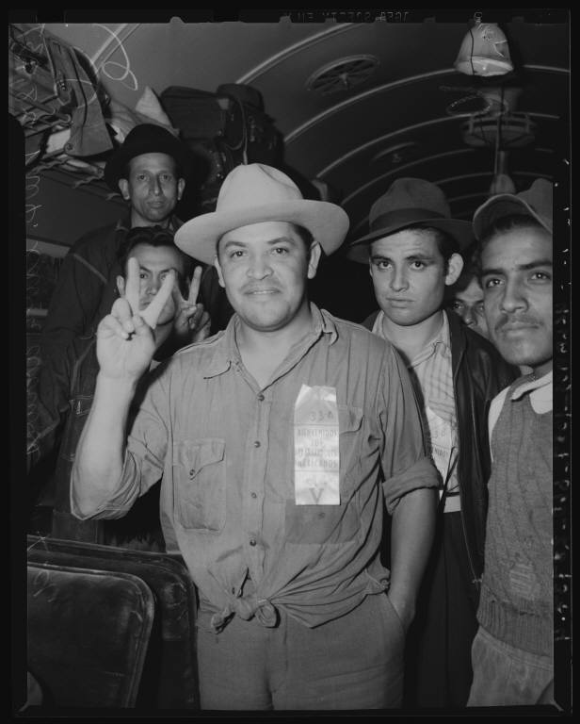
War at Home (Women and Minorities were needed)
Mexicans
Bracero Program 1942-1965
Temporary importation of workers from Mexico to aid the American agricultural.
Mexican worker allowed entry into the United States for a limited time, usually to work on a farm.
Hispanics also served in WW2.
http://www.youtube.com/watch?v=sTgL9clv0t8&feature=player_detailpage

Slide 6
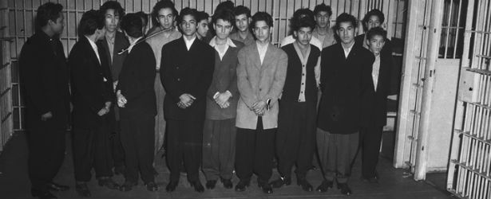
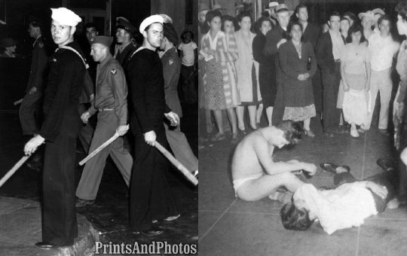
War at Home (Women and Minorities were needed)
Mexicans
Zoot suit riots
Racial tensions grew with an increase of Military people in CAL.
Young Mexican wore zoot suits as a rebellious fashion statement
They were seen as unpatriotic because they were not saving fabric for the war
This caused many, many riot in California cities
http://www.youtube.com/watch?v=dwINn5DEL1c&feature=player_detailpage

Slide 7
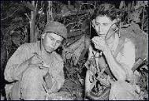
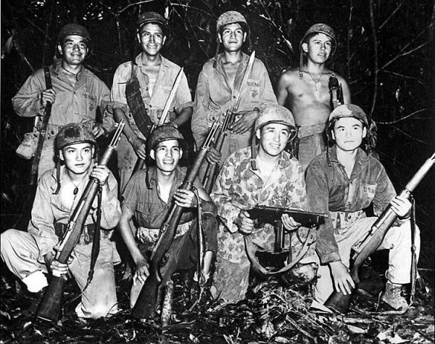
War at Home (Women and Minorities were needed)
Native Americans
For everyone 1 drafted, 2 volunteered
Very patriotic
Used as code talkers
Used Navajo language
Were part of the “white” units
Treated as equals during war –not so when they came home
http://www.youtube.com/watch?v=LN2oKqa1o04&feature=player_detailpage

Slide 8
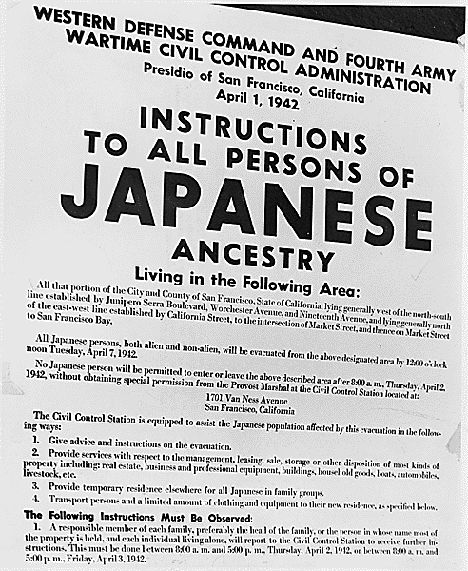
Interment of Japanese, Italians and the Germans
Enemies of the State
When the USA join the war certain people living in the USA became enemies of the USA
Japanese, Germans, and, Italians
President Roosevelt signed Executive Order 9066 on Feb. 19, 1942
Japanese and others were ordered to leave their homes and go to relocation camps

Slide 9
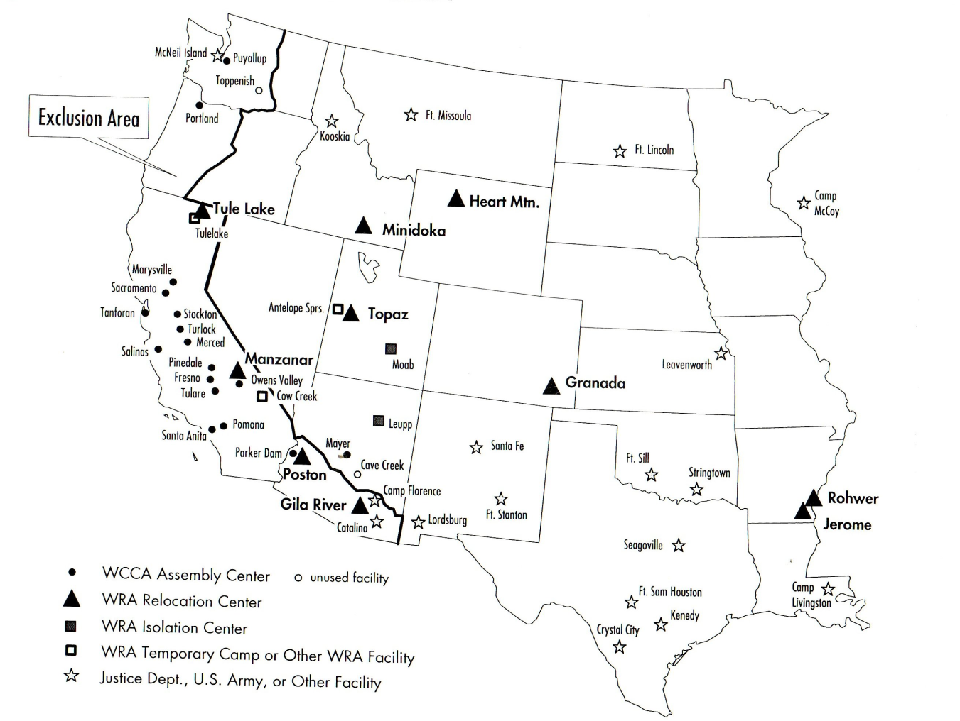
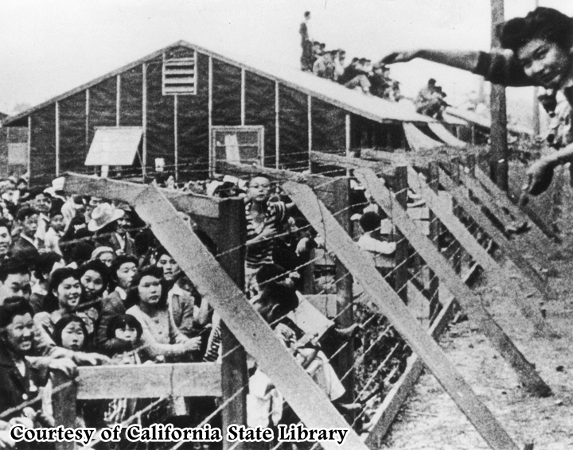
http://www.youtube.com/watch?v=6mr97qyKA2s&feature=player_detailpage

Slide 10
Was internment against the constitution?
Fred Korematsu was a Japanese-American man who decided not to follow the order.
He was arrested
He took his case to the supreme court: Korematsu v. United States
The court sided against him, arguing that race did not factor into the internment of Japanese Americans and that interment was a military necessity.
In 1988 Congress passed the Civil Liberties Act:
USA government apologized for internment
Paid $20,000 to each internment survivor
Violated Rights 1,4,5,6,15,

Slide 11
Jews?
The Jewish populations of Europe were slowly being destroyed
At first they were allowed to voluntarily move out of Germany
Other nations did not want Jews
They had no place to go
Jewish people event attempted to come to the USA
A ship the SS St. Louis was full of Jewish immigrants trying to come to the USA
They were turned away in Cuba and Miami, Florida
USA turned them away because they were not allowing Jewish immigrants into the USA
90% died

Slide 12
Questions
Make sure to watch all the videos!
How did the USA entering WW2, effect the lives of women?
Why were Mexicans allowed to enter the USA during WW2?
What did Mexican-Americans have to deal with during WW2?
Why were Japanese- Americans put in interment camps?

